Slide 1
Statistical Methods
trainerajay.iitj@gmail.com

Slide 3
Data Questions that need to be addressed…
Some times its difficult to analyse the data by just visualising it
How important is the column that you analysing a.k.a Feature Importance
To build a ML model how many features or which features i can use

Slide 4
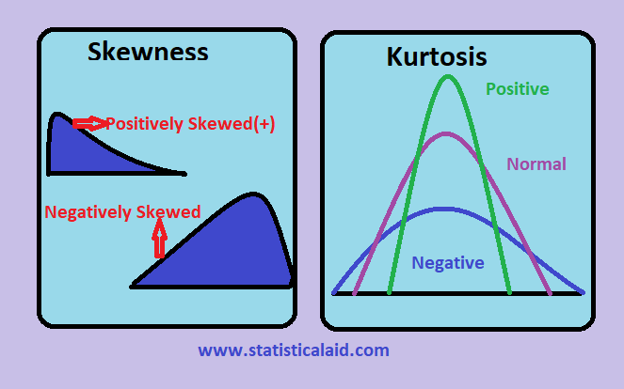
Descriptive Statistics
Mean Value
Min-Max Value
Standard Deviation
Skewness
Kurtosis

Slide 5
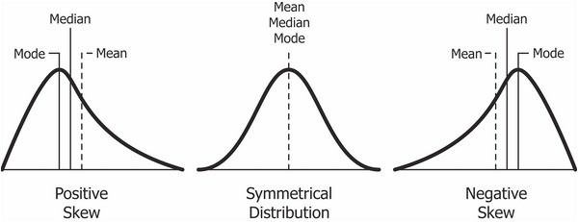
Skewness
If the skewness is between -0.5 and 0.5, the data are fairly symmetrical
If the skewness is between -1 and — 0.5 or between 0.5 and 1, the data are moderately skewed
If the skewness is less than -1 or greater than 1, the data are highly skewed

Slide 6
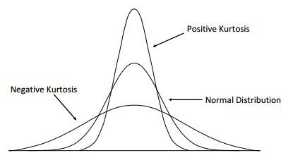
Kurtosis
Kurtosis is one of the two measures that quantify shape of a distribution. kutosis determine the volume of the outlier
Excess kurtosis = Kurt – 3
Types of excess kurtosis
Leptokurtic or heavy-tailed distribution (kurtosis more than normal distribution) >3
Mesokurtic (kurtosis same as the normal distribution) 0
Platykurtic or short-tailed distribution (kurtosis less than normal distribution) <3

